Slide 1






ATTC
Orientation Program on
By Sadat.H
IT administrator
Oct 06/10/2023

Slide 2
Contents
What is E-Learning
Advantage of E-learning
Types of E-learning
Participants of Moodle (E-Learning )
Courses in moodle LMS
Access ATTC E-learning Portal
Access your E-learning Account on ATTC E-learning portal.
Activities and Resources
Learning Resource
Learning Activities

Slide 3




What is E-Learning
E-learning is a computer based educational tool or system that enables you to learn anywhere and at any time.
E-learning offers the ability to share material in all kinds of formats such as videos, slideshows, word documents and PDFs by using Learning management software.

Slide 4

Advantages of E-learning
Just-in-time knowledge
Anytime and anywhere learning
Uniform training to a geographically dispersed workforce
Reduced training time and costs
Interactive and collaborative learning
Self-paced learning
Effective and efficient life-long learning – on demand
Resource saving (eg. paper)

Slide 5
Types of Learning
Synchronous Learning:
Synchronous learning is just like classroom learning except that the instructor and all the learners could each be in an entirely different location.
Synchronous e-learning is suitable for concept-based training, training of very complex
concepts, and sometimes training for learners who require the presence of a trainer.
Synchronous learning happens via:
Virtual classrooms
Audio and video conferencing
Chat
Webinars
Application sharing

Slide 6
Cont …
Asynchronous Learning
Generic training that has a long shelf life and does not pertain to a particular group of people such as soft skills training, management training, and financial training can be conducted via asynchronous e-learning.
Asynchronous learning makes use of media that is not instantaneous:
Self-paced online courses
Discussion forums & groups
Messages boards
Emails
Discussion forums
CDs and DVDs

Slide 7
Cont…
Blended Learning
Blended learning is a mix of synchronous and asynchronous learning. The proportion of each of the blended ingredients will depend on the audience, the amount of independence and guidance required during the training/learning.
Blended learning can also be a blend of:
Offline and online courses
Structured and unstructured learning
Self-paced and collaborative learning
Customized content and off-the-shelf content
Work and learning

Slide 8


































Users of E-learning or Moodle Participants
Administrator:
Install the app
Create course and category
Register and enroll E-learning users
Administrating the site
Customizing the home page content
E-learning
System
Teacher:
Create an activities such as quiz ,
Assignment ,forum and etc
Add a resources for student such
As book and videos etc
Grouping students
Learner or student :
Access the resource
Participate on moodle activities
Uploading discussion forum

Slide 9
Courses in moodle LMS
Courses are the spaces on Moodle where teachers add learning materials and activities for their students.
Courses may be created by Admins, course creators or managers.
Teachers can then add the content and re-organise them according to their own needs.

Slide 10
Course settings :elements of course
Course full name
Short name
Course category
Course start date
Course end date
Course visibility

Slide 11
What is Activities & Resource
An activity is a general name for a group of features in a Moodle course.
Usually an activity is something that a student will do that interacts with other students and or the teacher.

Slide 12
Activities Cont..
Assignments Enable teachers to grade and give comments on uploaded files and assignments created on and off line
Chat: Allows participants to have a real-time synchronous discussion
Choice : A teacher asks a question and specifies a choice of multiple responses
Database: Enables participants to create, maintain and search a bank of record
entries
Feedback: For creating and conducting surveys to collect feedback. (The administrator needs to enable this.)
Forum: Allows participants to have asynchronous discussions
Glossary: Enables participants to create and maintain a list of definitions, like a dictionary
Lesson: For delivering content in flexible ways
Quiz: Allows the teacher to design and set quiz tests, which may be automatically marked and feedback and/or to correct answers shown
Survey: For gathering data from students to help teachers learn about their class
and reflect on their own teaching
Wiki: A collection of web pages that anyone can add to or edit
Workshop: Enables peer assessment

Slide 13
Cont …
A resource is an item that a teacher can use to support learning, such as a file or link.
Moodle supports a range of resource types which teachers can add to their courses. In edit mode, a teacher can add resources via the 'Add an activity or resource' link.

Slide 14
Resources Cont …
Book - Multi-page resources with a book-like format. Teachers can export their Books as IMS Content Packaging (admin must allow teacher role to export IMS)
File - A picture, a pdf document, a spreadsheet, a sound file
&etc.
Folder - For helping organize files and one folder may contain
other folders
Label - Can be a few displayed words or an image used to separate resources and activities in a topic section, or can be a lengthy description or instructions
Page - The student sees a single, scrollable screen that a
teacher creates with the robust HTML editor
URL - You can send the student to any place they can reach on
their web browser, for example Wikipedia

Slide 15
Grouping users
Groups: On the course level you can assign a user to one (or more) groups. In a course you can assign a context(activity) to a group. When members of the group leave the course, they lose their identity with the group.

Slide 16
To Access ATTC E-learning site
ATTC E-Learning Site url (http://10.128.16.36/moodle)
write the address on the browser url
Click Login button
Insert your own username and password
The system automatically enforce you to change the password.
Your password must have 8 characters, at least 1 digits ,at least 1 lower case letters ,at least 1 upper case letters ,at least 1 non – alphanumeric characters such as *,-,_, or #

Slide 17
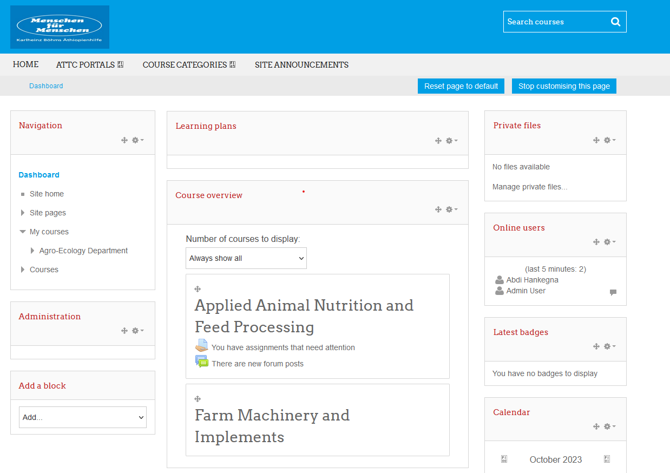
http://10.128.16.36

Slide 18
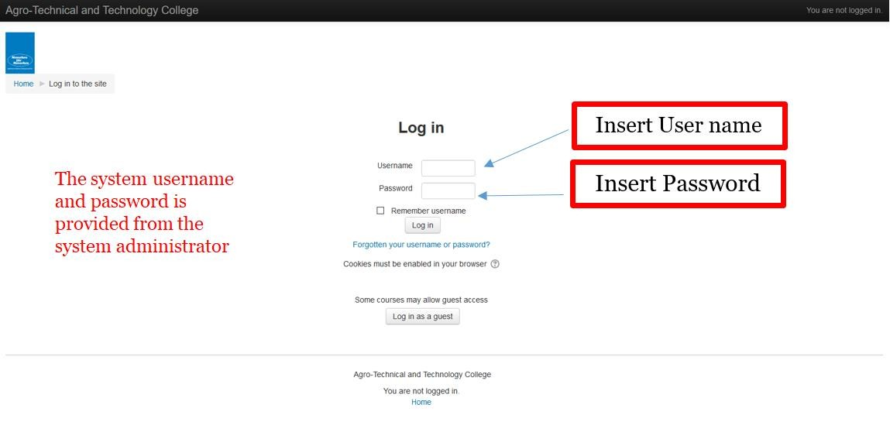
Login to the system

Slide 19
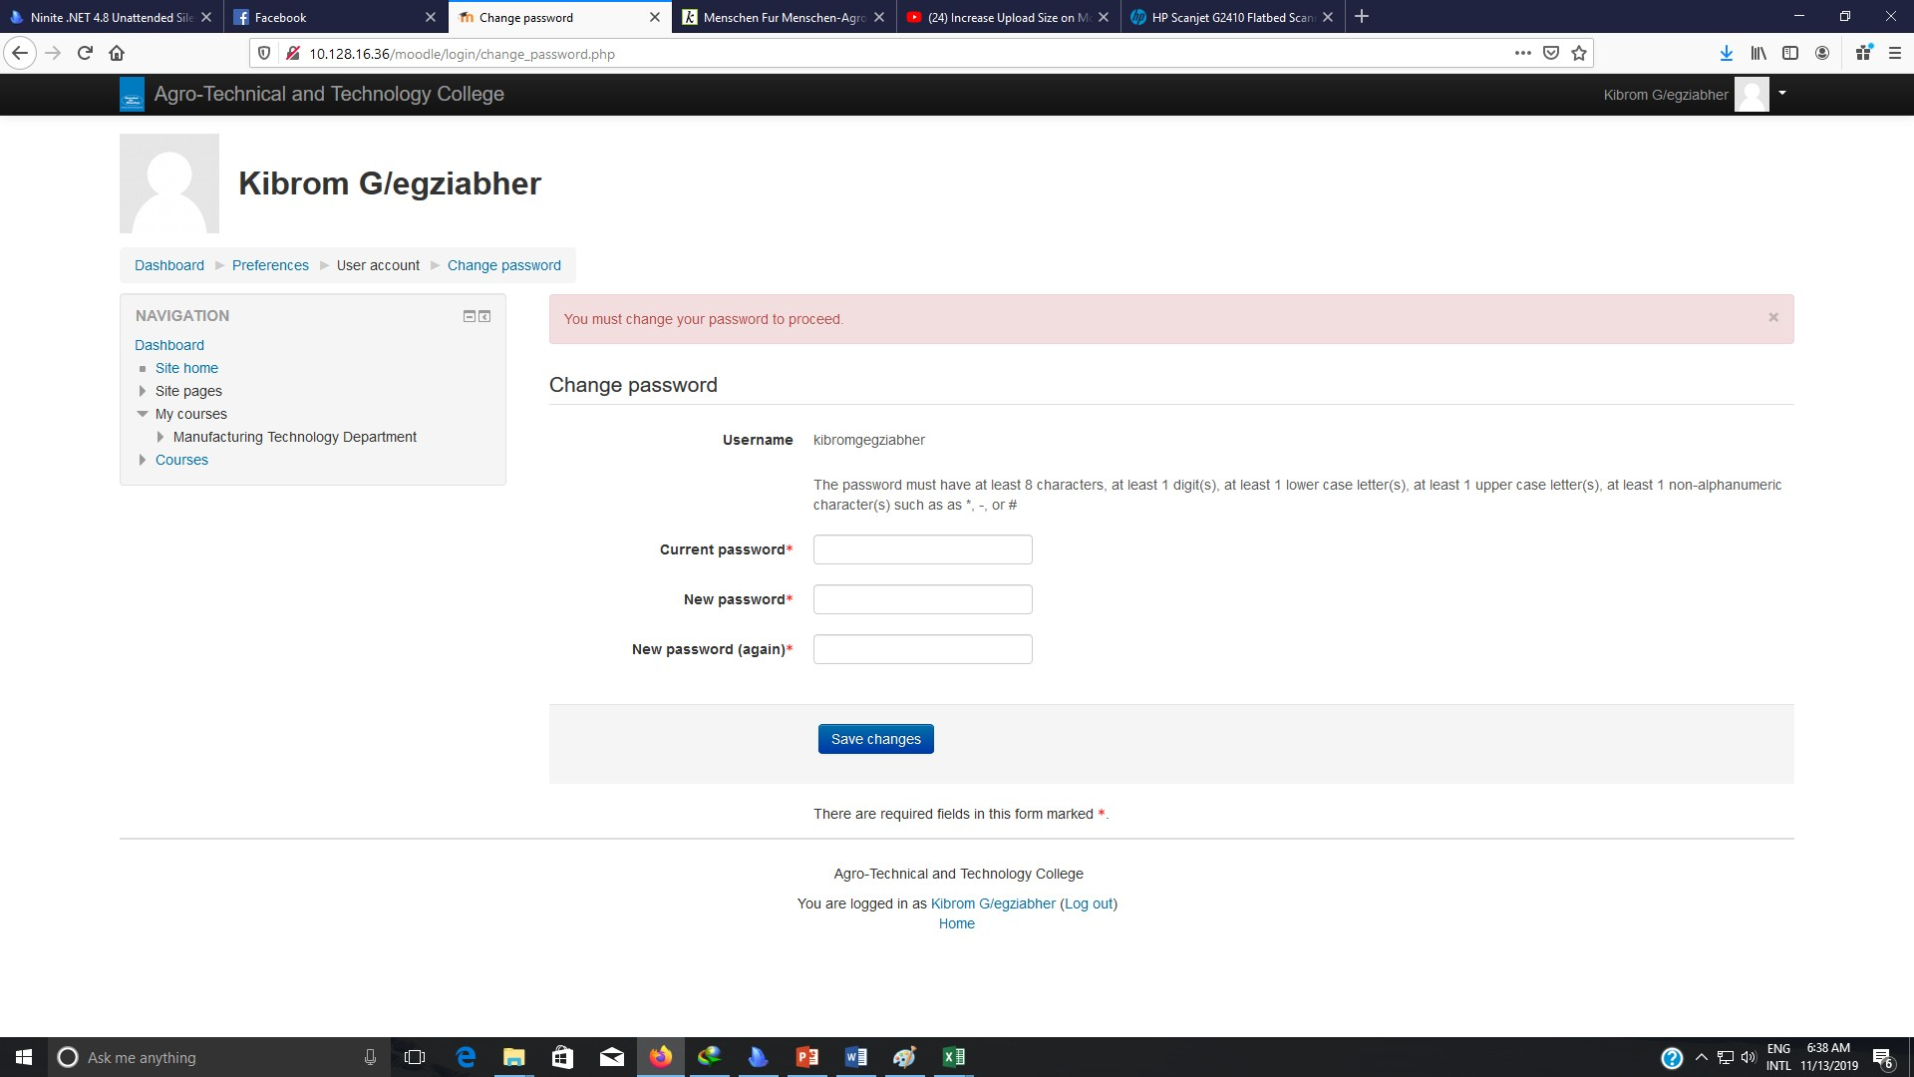
Change your password

Slide 20

Question

Slide 21





uch !

